Slide 1
Actions needed to halt deforestation and promote climate-smart agriculture
Notes:
Date: 8 June, 2011 Time: 15:15 - 16:45 Venue: Ministry of Transport: Room TRAM. Location: Bonn, Germany

Slide 2
What is Needed
Integrated action across REDD+ and agriculture will help mitigation and food security
‘Climate-smart’ agriculture that achieves the triple-win of food security, adaptation and mitigation will strengthen the impacts of REDD+

Slide 3
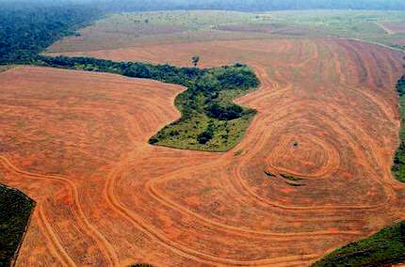
1. Integrated action will help mitigation and food security
Soybean plantation, Brazil
Notes:
~ 1/3 of global emissions related to agriculture & related land use change (forest conversion)
Agriculture is major driver of deforestation -16/20 countries gave agriculture as major driver in R-PPs (CCAFS report, Kissinger 2011)
., Agriculture contributes to about three-quarters of tropical deforestation
Agriculture is a primary driver of deforestation in most countries, including in Brazil and Indonesia, where 61% of global deforestation occurs. P Nepstad D, et al. 2009. The End of Deforestation in the Brazilian Amazon. Science 326:1350-1351
DeFries R, et al. 2010. Deforestation driven by urban population growth and agricultural trade in the twenty-first century. Nature GEOSCIENCE 3:178-181.

Slide 4
Increasing Demand for Food, Limited Land Reserve
9 billion people by 2050—require 70 to 100% increase in food
But only about additional 10% of current arable, non protected land will be available (445 Mha) (Lambin 2011)
And the competition will be stiff
Notes:
Land available in This land reserve is mostly concentrated in Latin America’s cer- rados and grasslands (Brazil, Argentina) and in African savannas (Sudan, Democratic Republic of the Congo, Mozambique, Tan- zania, Madagascar).
Climate change variability

Slide 5
2. Climate Smart Agriculture can strengthen REDD+
Agriculture can significantly contribute to mitigation
Reduce land use change
Increase carbon sequestration (soil, agroforestry)
Reduce emissions (Nitrous oxide, methane)
No one-size-fits-all solution

Slide 6
Many Agricultural Options
Sustainable intensification: increasing crop yields per area to reduce pressure for forest conversion
Sustainable agricultural land management to reduce emissions and increase food production and resilience
Target expansion to rehabilitated degraded areas
Diverse agroforests, forest-fallow or high-carbon and high-biodiversity production systems
Notes:
Quaifying factors; can lead to more expansion (so need policies to enforce and provide incentives), time limited effects, not always land to spare, intensification not at boundary,

Slide 7
Solution: Integrating Agriculture
Address agricultural drivers:
Governance and institutional design: land tenure, macro drivers, integrated “landscape” projects, national climate action plans
Invest in agricultural options that reduce pressure on forests and increase food security
Finance ‘Climate-smart’ agriculture that achieves the triple-win of food security, adaptation and mitigation

Slide 8
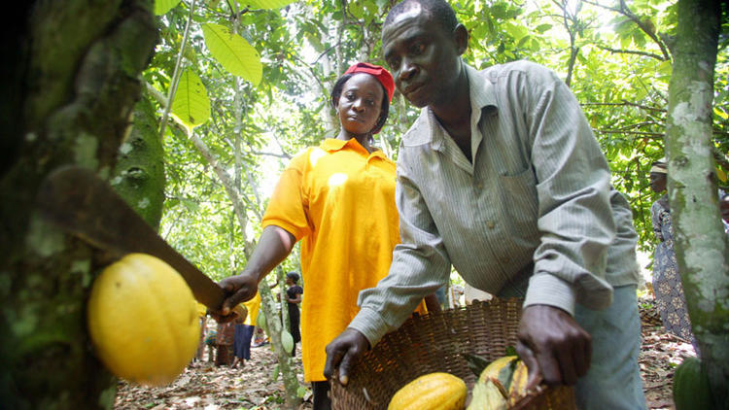
Link to economic development policies to meet the needs of smallholder farmers and reduce poverty and local food insecurity near forests

Slide 10
Deforestation by small and large farmers, varies regionally
Blaser J, Robledo C. 2007
Notes:
Blaser J, Robledo C. 2007. Initial analysis on the mitigation potential in the Forestry sector. Prepared for the UNFCCC Secretariat. Intercooperation, Bern.

